Slide 1






DEEP LEARNING APPROACHES FOR FRAUD DETECTION IN E – COMMERCE TRANSACTIONS
Video Link : https://youtu.be/Jj2223LHf6s
PREPARE BY : MOHAMED AZLAN AMEER OLI- MCS241050
SV : PROF. MADYA DR. MOHD. SHAHIZAN OTHMAN

Slide 2



PREPARED BY :
MOHAMED AZLAN AMEER OLI
ASSOC. PROF. DR. MOHD SHAHIZAN BIN OTHMAN
MCS241050 Master Data Science Student
Lecturer, Universiti Teknologi
Malaysia (UTM)

Slide 3
TABLE OF CONTENTS
Chapter 1: Introduction
Chapter 2: Literature Review
Chapter 3: Research Methodology
Chapter 4: Initial Findings & Results
Chapter 5: Future Works

Slide 4

INTRODUCTION

Slide 5

Problem Statement
Rise of cashless payments and online transactions introduces new fraud risks
Traditional methods rely on manual checks or simple rule-based systems
Struggle to process large volumes of financial data
Class imbalance: Fraud cases are rare compared to legitimate transactions
Leads to poor detection accuracy with conventional models
Fraud tactics evolve rapidly, making static systems ineffective
Highlights the need for intelligent, adaptive detection solutions (Nama & Obaid, 2024)

Slide 6

Proposed Deep Learning Approach
Deep learning can uncover hidden patterns in large transactional datasets
This research introduces an adaptive fraud detection system
Combines Recurrent Neural Network (RNN) and Long Short-Term Memory (LSTM) models
Offers a more accurate and responsive solution for e-commerce fraud prevention

Slide 7
Research Aim
This project aims to identify fraud and non – fraud transactions in e – commerce using RNN and LSTM models and identify which is the best model to predict the fraudulent activities in e-commerce.

Slide 8
Research Objectives
The objectives of this study are follows:
A. To investigate the deep learning – based approach for fraud transactions detection.
B. To implement the method used for fraud transactions detections based on deep learning method.
C. To predict the accuracy of the model used for fraud transaction detection

Slide 9
Research Scope
The scopes of this project are bound under the following constraints to accomplish this work:
A. The study utilizes the dataset of the synthetic dataset of Fraudulent activities in e-commerce.
B. The experiment related will be developed in Python programming.
C. The proposed model used Recurrent Neural Networks (RNNs) and Long Short – Term Memory (LSTM)

Slide 10
Expected Research Contribution
Evaluate deep learning models for fraud detection
Identify the most effective approach using RNN and LSTM
Develop a real-time fraud detection system with a visual dashboard
Help enhance security of e-commerce platforms

Slide 11
LITERATURE REVIEW

Slide 12
Literature Review
Deep Learning & Machine Learning Techniques
E - Commerce Transaction
Research that uses e - commerce transactions dataset to analyze the pattern of the transaction and help to detect fraud and non - fraud.
Research that studies various deep learning and machine learning techniques to detect fraud transactions.
Finding Best Model
Research that finds best models of Deep Learning that use to detect fraudulent activities at E - Commerce transactions.

Slide 13
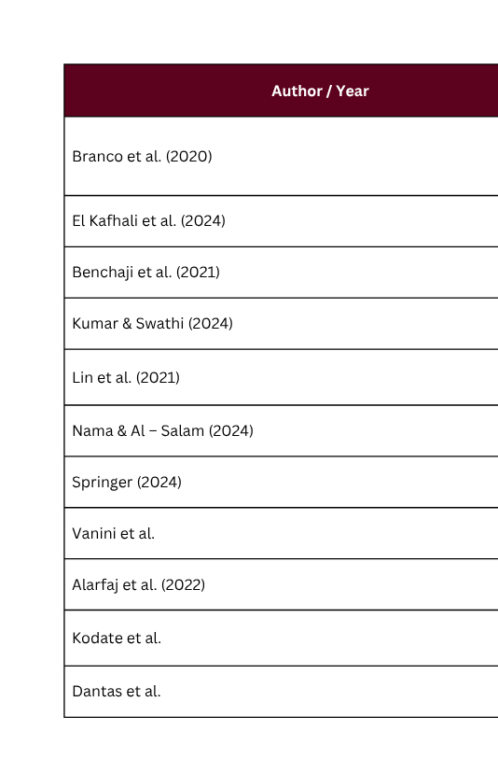
Previous studies on results of Supervised Learning Method

Slide 14
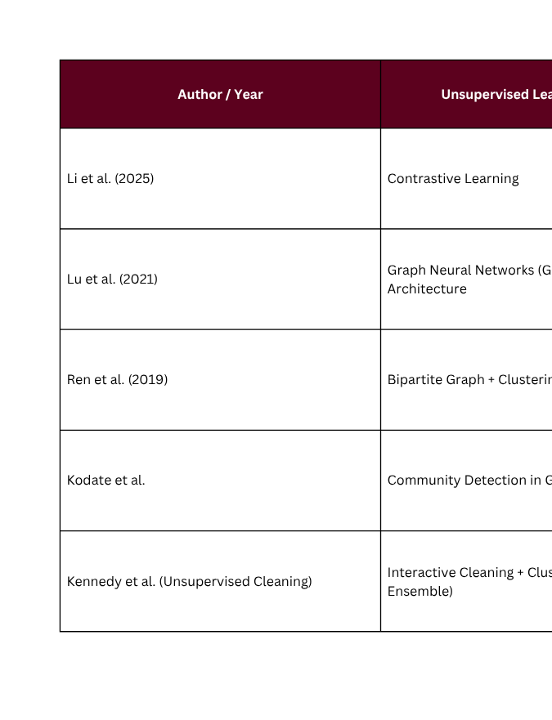
Shows previous studies results of Unsupervised Learning Method

Slide 15
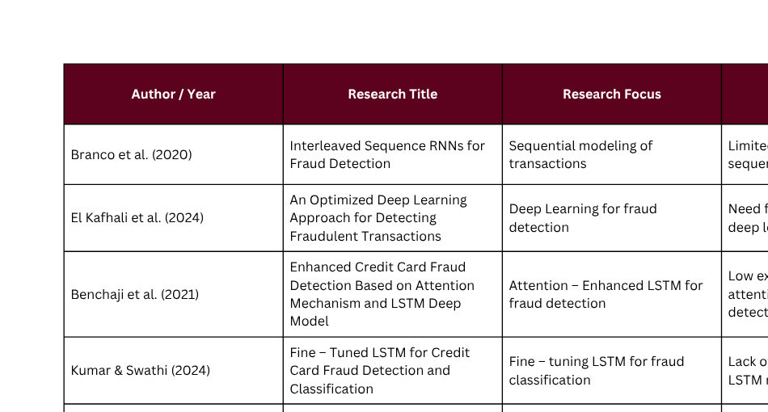
Shows the previous work of researcher in Deep Learning Methods

Slide 16
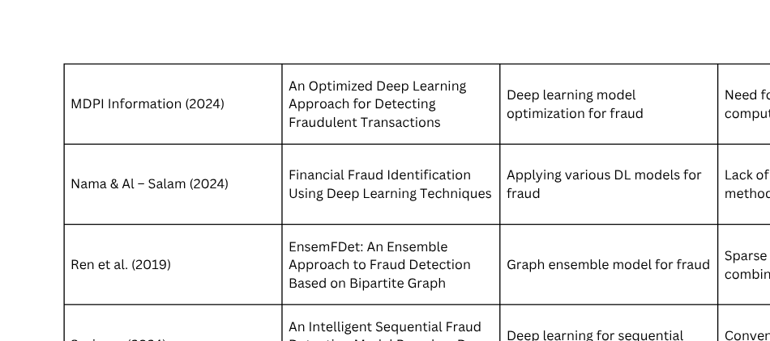
Shows the previous work of researcher in Deep Learning Methods

Slide 17
Literature Review
Research Gaps
Solutions
Data Limitation in Current Models: While models like LSTM and RNN perform well in fraud detection, they require large labeled datasets, which are often unavailable in real-world scenarios—highlighting the need for semi-supervised or unsupervised methods.
Narrow Focus on Credit Card Fraud: Most studies focus on credit card fraud, not the broader and more complex e-commerce fraud landscape that includes multiple platforms and payment types.
Need for Advanced, Real-Time E-Commerce Solutions: Future research should develop deep learning models that handle limited data, work in real-time, are more interpretable, and are tailored to the unique characteristics of e-commerce fraud.
Adopt Semi-Supervised and Unsupervised Learning Techniques
Design E-Commerce-Specific Fraud Detection Models
Integrate Real-Time and Multi-Modal Data Processing

Slide 18
RESEARCH METHODOLOGY

Slide 19


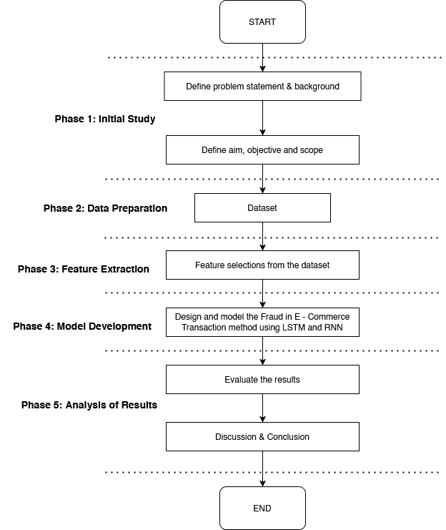

Research Frame Work
This research framework includes the following steps:
Phase 1: Initial Study – Conducts background research and explores existing issues in e-commerce fraud detection.
Phase 2: Conceptual Design and Development – Outlines the structure of the proposed deep learning model and selects appropriate methods and tools.
Phase 3: Model Development – Builds the deep learning models (LSTM and RNN) for fraud detection based on the defined concepts.
Phase 4: Implementation – Applies the developed models to the selected dataset to detect fraudulent transactions.
Phase 5: Analysis of Results – Compares the performance of LSTM and RNN models, aiming to achieve the highest possible detection accuracy.
Objective 1
Objective 2
Objective 3

Slide 20

Phase 1: Initial Study
This research framework includes the following steps:
Background & Problem Statement
Rise of online and cashless transactions increases complexity in fraud detection.
Traditional rule-based systems struggle with large-scale and imbalanced data.
Fraudulent transactions are rare, making them harder to detect accurately.
Need for real-time, adaptive models due to evolving fraud techniques. (Nama & Obaid, 2024)
Deep Learning in Fraud Detection
RNN and LSTM are effective in capturing transaction patterns.
Real-world deployment faces issues with imbalanced & growing datasets.
Bayesian optimization helps improve model accuracy and efficiency.(Branco et al., 2020; Lin et al., 2021; El Kafhali et al., 2024)

Slide 21
Phase 2: Data Preparation
This research framework includes the following steps:
Dataset Summary
Total Transactions: 1,472,952
Features: 16
Non-Fraudulent: ~95%
Fraudulent: ~5%
Data Preparation Steps:
Removed missing values, duplicate rows, and inconsistencies
Irrelevant data excluded to improve model accuracy
Text Preprocessing: Converted to lowercase, removed irrelevant terms
Date Formatting: Standardized transaction timestamps

Slide 22
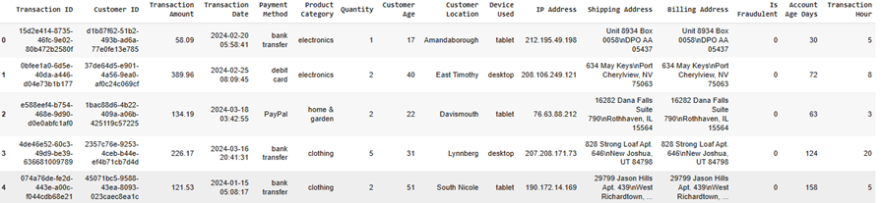
Phase 3: Feature Extraction
This research framework includes the following steps:
Feature Extraction & Preprocessing
Extracted key features: Transaction Date, Payment Method, Product Category, Customer Location, Device Used
Standardized text: lowercased, removed extra spaces
Reformatted date for temporal analysis
Removed missing values and duplicate entries
Encoded categorical variables for model input
Used heatmaps and bar plots to identify predictive features
Final output: Cleaned and scaled dataset ready for RNN and LSTM model training
Dataset Summary

Slide 23
Phase 4: Model Development
This research framework includes the following steps:
Model Development & Evaluation
Models: LSTM and RNN used to detect fraudulent transactions in e-commerce.
Data Split: 80% training, 20% testing; input reshaped to 3D (samples, time steps,
features).
LSTM Architecture:
Input layer
LSTM layer with 64 units
Dense layer with sigmoid activation (binary output)
Training Setup:
Loss: Binary cross-entropy
Optimizer: Adam
Batch size: 64 | Multiple epochs
Validation set used to prevent overfitting
Evaluation Metrics:
Accuracy, Precision, Recall, F1-Score, Confusion Matrix
RNN: Trained and evaluated using the same approach for result comparison

Slide 24
Phase 5: Analysis of Results
This research framework includes the following steps:
In this phase, the output of the fraudulent transaction detection is analyzed. The model between LSTM and RNN comparison in terms of accuracy and prediction has been validated. The output is based supervised learning on fraud and non – fraud transactions. The performance measure of the data has been discussed in this phase.

Slide 25
Exploratory Data Analysis (EDA)
This research framework includes the following steps:
In this phase, the output of the fraudulent transaction detection is analyzed. The model between LSTM and RNN comparison in terms of accuracy and prediction has been validated. The output is based supervised learning on fraud and non – fraud transactions. The performance measure of the data has been discussed in this phase.
EDA helps visualize data to uncover patterns and anomalies.
Begins with understanding the data and identifying potential issues.
Checks for missing values and inconsistencies, which are handled by removal or imputation.
Analyzes data distribution, averages, and overall structure.
Applies SMOTE for handling class imbalance and improving dataset quality.
Uses visualizations (graphs, charts) to highlight trends and insights.
Detects and addresses outliers to ensure reliable analysis.
Final findings summarized through visual and statistical outputs.

Slide 26
Steps of Exploratory Data Analysis (EDA)

Slide 27
Data Collection
This research framework includes the following steps:
Figure 4.1: Fraudulent E-Commerce Transactions Dataset

Slide 28
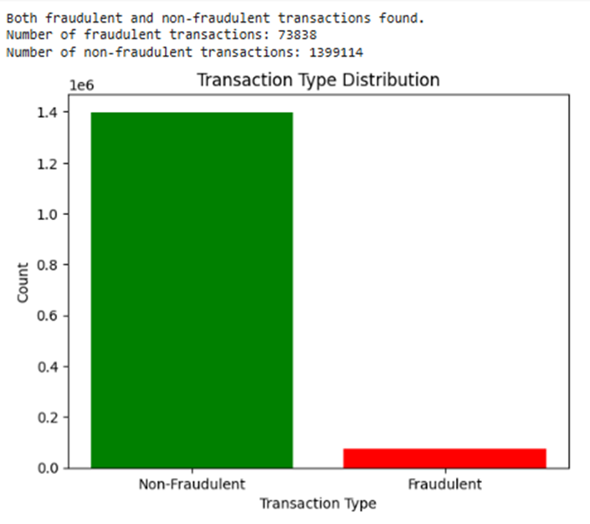
Import and Inspect Dataset
This research framework includes the following steps:
Figure 4.1: Fraudulent E-Commerce Transactions Dataset
Figure 4.2: Transactions Type Distribution

Slide 29
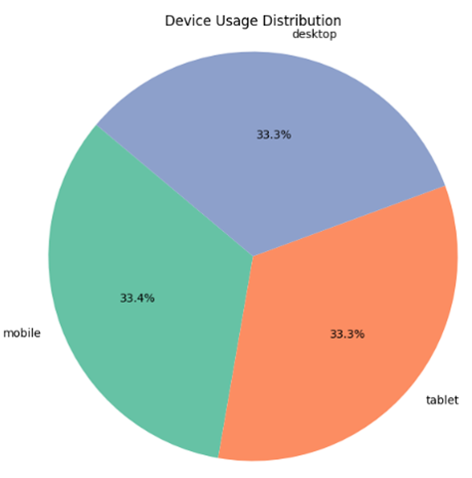
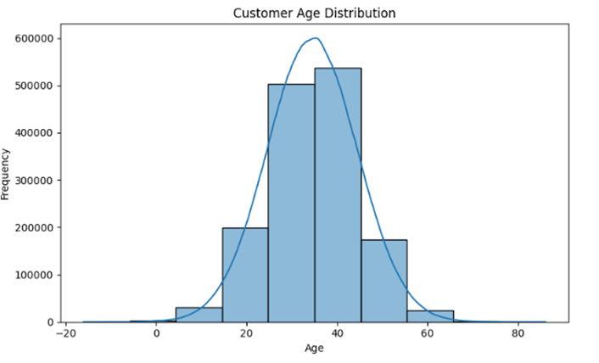
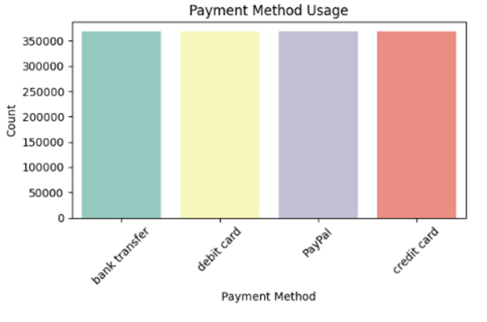
Demographic and Distribution Data
Figure 4.4: Device Usage Distribution
Figure 4.3: Customer Age Distribution
Figure 4.5: Payment Method Usage

Slide 30
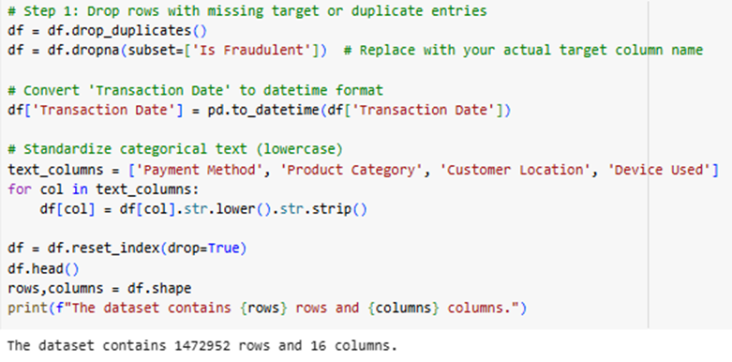
Data Cleaning
Figure 4.6: Data Cleaning Code

Slide 31
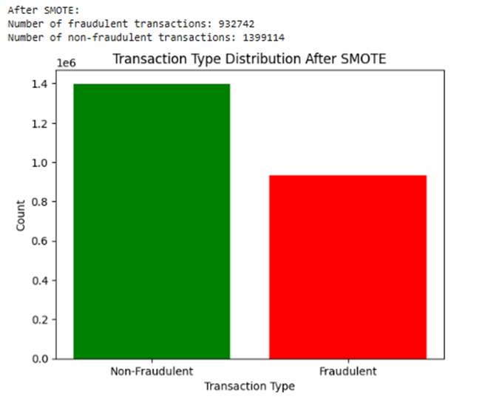
Using SMOTE Model for Balancing Data
Figure 4.7: Transaction Type Distribution After SMOTE

Slide 32
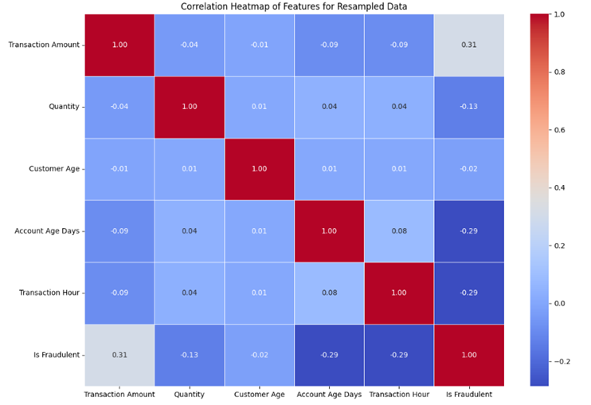
Feature Extraction
Figure 4.8: Correlation Heatmap of Features for Resampled Data

Slide 33
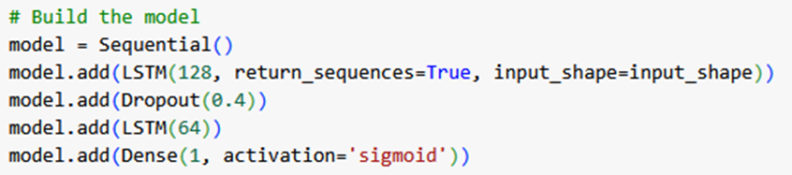
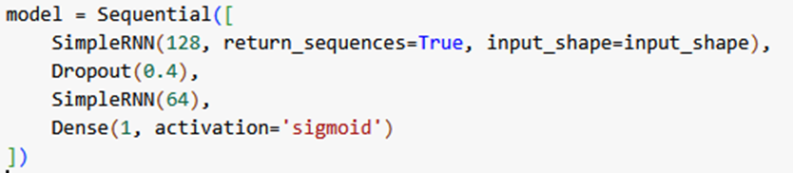
Data Modeling
Figure 4.9: LSTM Modeling
Figure 4.10: RNN Modeling

Slide 34
INITIAL FINDING AND RESULTS

Slide 35
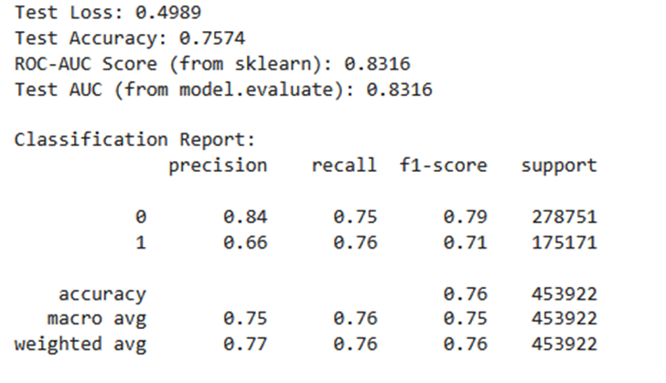
Initial Results
Figure 4.11: Initial Results of LSTM

Slide 36
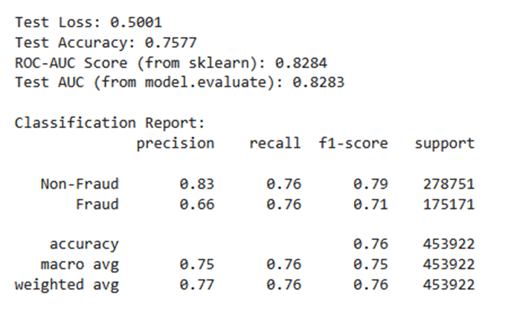
Initial Results
Figure 4.13: Initial Results of RNN

Slide 37
Future Work
Model Optimization and Tuning Parameter
Enhanced the Data Balancing Method
Although SMOTE was used to address class inconsistency, the minority class detection may be further improved by combining SMOTE with methods like cost – sensitive learning or ensemble under – sampling.
Future work should focus on optimizing hyperparameters such as Bayesian Optimization to enhance the performance of RNN and LSTM models. Furthermore, reducing overfitting may also be achieved by implementing the batch normalization or dropout layers.
Advanced Architectures
Using advanced neural networks such as Bidirectional LSTM and GRU (Gated Recurrent Units) may identify deeper sequential patterns. Also, time series analysis may better for model fraud patterns.

Slide 38


Feature Extraction
- THANK YOU -

